Slide 1

CG1112
Engineering Principles and Practices II for CEG
Week 8 Studio 2
Communication Protocols
colintan@nus.edu.sg

Slide 2
Introduction
In a previous studio you learnt how to establish communications with your Arduino using serial communications.
In this lecture we will look at “communications protocols”
A “protocol” is an agreement between machines on how to represent data.
In particular we will be looking at application layer protocols.
In the previous studio we saw:
Physical layer protocols – Agreement on voltage levels, number of wires to use, how wires are to be connected, etc.
Link layer protocols – How bits are placed together into units called “frames”, what the layout of each frame should be, etc.
Application layer protocols:
How we arrange instructions and data within a data structure for controlling behaviors of remote systems.

Slide 3

Three things to do:
Decide on physical connection:
Easy enough; we will connect the Arduino to the Pi using USB.
Decide on bit-level protocol:
Decide baud rate.
Decide data length.
Decide # of parity bits.
Decide # of stop bits.
Standard is 115200 8N1.

Slide 4
Building a protocol
Serial Communication and Protocol Design

Slide 5
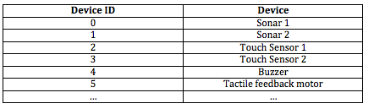
Assign an ID to each device
You need to be able to identify sensors (actuators) to read from (send data to).

Slide 6
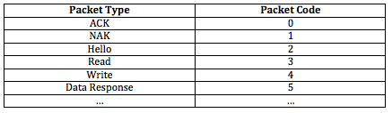
Create Packet Types
So both sides know what sort of packets are being sent (and the appropriate response)

Slide 7
Getting Data from the Arduino
Your Arduino may have data to send back to the Raspberry Pi (RPi):
Compass readings.
Number of turns the wheels have made.
Etc?
You have two choices:
Arduino can periodically send back data in “heartbeat packets”.
These are packets sent back say once per second, containing data and status information.
RPi can poll for data.
RPi sends a request for data.
Arduino replies.

Slide 8
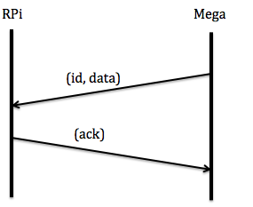
Periodic Push By Arduino
RPi
Arduino
Arduino sends data whenever it is available.
Often implemented as a “heartbeat” packet.
RPi monitors and buffers data as it comes in.
+Arduino sends data whenever it is available.
-RPi needs to buffer incoming data.

Slide 9
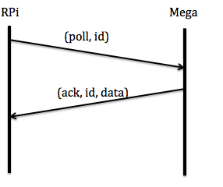
Periodic Poll by RPi
RPi
Arduino
Arduino waits for poll packets from RPi.
RPi requests data when it needs it.
+RPi decides when it needs the data and sends poll packet.
-If RPi doesn’t poll often enough, may lose data on Arduino (Arduino has only 2K of RAM)

Slide 10
Commanding the Arduino
You can use a variation of the “poll” packet to send commands to the Arduino:
E.g. tell Arduino to move Vincent forward by 1 meter at 50% speed.
The Arduino responds immediately with an ACK packet.
The RPi can either:
Poll the Arduino continuously to check when it has finished the command, OR
The Arduino can send back a packet to inform the RPi that it is done.
(move, 50, 1)
(move, 50, 1)
(ack)
(ack)
(poll)
(done)
(done/notdone)

Slide 11
Finding Checksums
Checksums are used to check that data is received correctly.
Sender side:
Compute checksum
checksum = b1 XOR b2 XOR b3 XOR b4 XOR…
Attach to end of packet.
Receiver side:
Compute checksum using data in packet, except checksum.
Compare against attached checksum.
If equal, reply with ACK, else reply with NAK.

Slide 12
Finding Checksums
For the most part:
Serial comms is reliable.
Hence we don’t normally compute checksums (or send ACK for that matter).
However:
Your set up is not going to be perfect.
If you are sending relatively large amounts of data, higher chance of errors.

Slide 13
Serializing Structures
The easiest way to implement the protocol packets is as structures.
Example for our command packet:
typedef tc
{
int command;
int speed;
int distanceInMeters;
} TCommand;
Serializing: Converting a structure into a stream of bytes, because serial devices can only deal with streams of bytes.
Get a pointer to the structure.
Copy into an array of char.
May want to include information on packet length and checksum.

Slide 14
Serializing Structures
typedef struct con
{
unsigned char devCode;
double maxValue;
double minValue;
} TConfigPacket;
void sendConfig()
{
TConfigPacket cfg;
char buffer[64];
cfg.devCode=deviceCode;
cfg.minValue = minValue;
cfg.maxValue = maxValue;
unsigned len = serialize(buffer, &cfg, sizeof(cfg));
}

Slide 15
Serializing Structures
unsigned int serialize(char *buf, void *p, size_t size)
{
char checksum = 0;
buf[0]=size;
memcpy(buf+1, p, size);
for(int i=1; i<=size; i++)
{
checksum ^= buf[i];
}
buf[size+1]=checksum;
return size+2;
}
void sendSerialData(char *buffer, int len)
{
for(int i=0; i<len; i++)
Serial1.write(buffer[i]);
}

Slide 16
Deserializing Structures
Deserialize: Convert a stream of bytes back to structures.
Get a pointer to the structure.
Copy buffer of bytes to that pointer:
May need to remove packet length and compute checksums first.

Slide 17
Deserializing Structures
Void readConfig()
{
char buffer[MAX_BUF_LEN];
int len;
TConfigPacket cfg;
readSerial(buffer, &len);
deserialize(&cfg, len);
// Process cfg.
…
}

Slide 18
Deserializing Structures
unsigned int deserialize(void *p, char *buf)
{
size_t size = buf[0];
char checksum = 0;
for(int i=1; i<=size; i++)
checksum ^= buf[i];
if(checksum == buf[size+1])
{
memcpy(p, buf+1, size);
return PACKET_OK;
}
else
{
printf("CHECKSUM ERROR\n");
return PACKET_BAD_CHECKSUM;
}
}

Slide 19
Serializing / Deserializing Structures
Our serializing / deserializing algorithms may not work in the real world because of two complications:
Endianness
Differing Data Sizes.
In addition:
The representation shown earlier is not efficient. We would use a separate data structure to store the data to be serialized, the checksum and the size of the data.
See serialize.zip for an example.

Slide 20
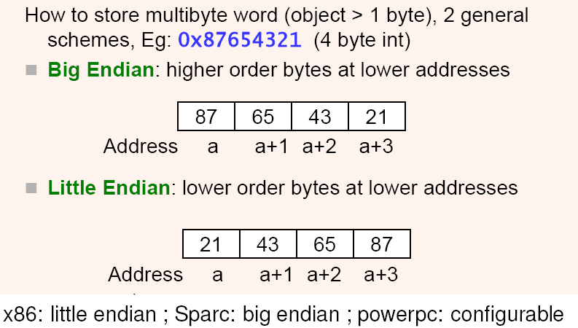
Complication #1 Endianness

Slide 21

Complication #1 Endianness
As it turns out:
The Arduino is little endian.
The Pi is little endian.
Our job here is done. ;)
Note though:
If your destination machine has a different endianness, our algorithm will not work.
Serializing / Deserializing will be considerably more troublesome.
Convert all data to a standard endianness.
At the destination, convert it back to the native endianness.
In such cases consider using established libraries like MAVLINK and protobuf.

Slide 22
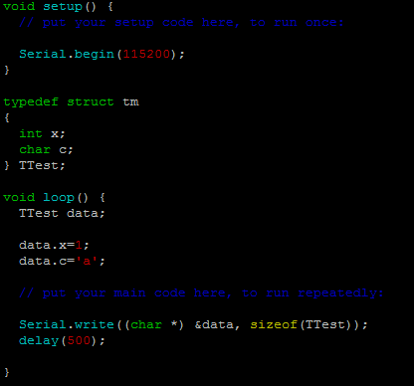
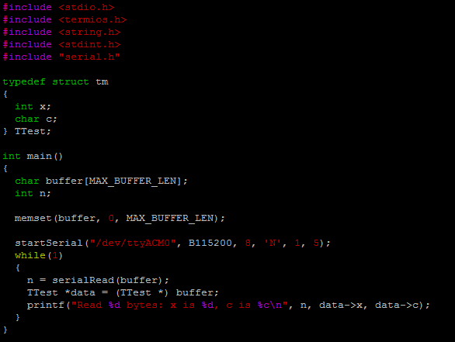
Complication #2 Different Data Sizes
We want to send over a data structure consisting of:
A single character, initialized to ‘a’.
An integer, initialized to 1.
As it turns out, the following code segments do not work. The sample printout on the Pi is shown on the next page:
Arduino Side
RPi Side

Slide 23
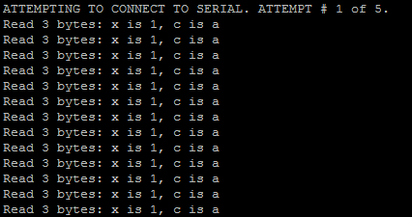
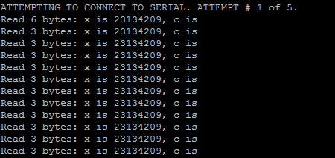
Complication #2 Different Data Sizes
Intended Output (RPi)
Actual Output (RPi)
We can see that the output is obviously wrong. BUT WHY?

Slide 24



Complication #2 Different Data Sizes
Turns out:
Ints on the Arduino are 16 bits wide, but ints on the RPi are 32 bits wide!
The diagram below shows the consequences:
What the Arduino sent
Our integer
x=1
Our character
c=‘a’
What the Pi THINKS the Arduino sent
Where the Pi thinks x is.
We end up with garbage
Where the Pi thinks c is.

Slide 25
Complication #2 Different Data Sizes
Fortunately there are two solutions:
Switch to Arduino Due, which has a 32-bit ARM architecture like the Pi.
However the hardware registers and how we access them is completely different.
Despair, fail CG1112, drop out and spend the rest of our lives pulling scraping dead animals off the streets.
Use standardized integer types
Replace:
int with int32_t
unsigned int with uint32_t
long with int64_t
unsigned long with uint64_t
Must remember to #include <stdint.h>
Floats are not affected.
Both the Arduino and Pi use 32-bit IEEE 754 format in little endian.

Slide 26
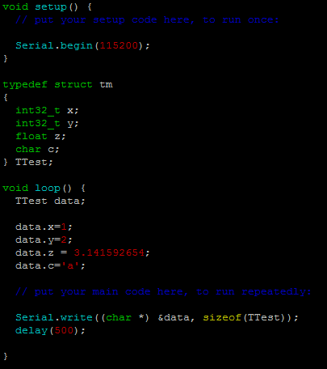
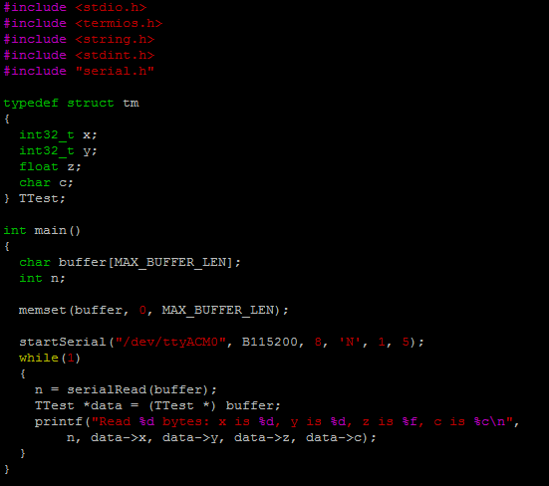
Complication #2 Different Data Sizes
Our corrected code (with additional integer y and a floating point z thrown in!):
Arduino Side
RPi Side

Slide 27
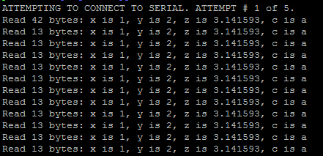
Complication #2 Different Data Sizes
Output (RPi side)

Slide 28
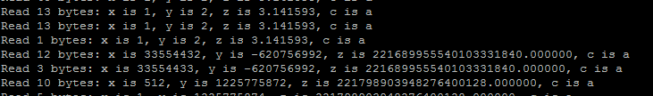
Bonus Complication
One bonus complication:
The serial receive doesn’t guarantee that you will receive the entire packet at one time.
You may receive fragments, which can cause errors as shown below:
Solution:
Test number of bytes received. If it is == size of data structure, accept. Otherwise buffer and add in subsequent bytes that arrive.

Slide 29
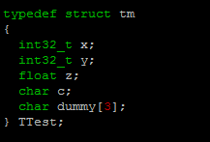
Bonus Complication
We do two things:
We pad the TTest structure so that its size in bytes is divisible by 4
This is to match what the compiler does on the Pi side:
We currently have 2 int32_t, 1 float and 1 char.
This totals 4 + 4 + 4 + 1 = 13 bytes.
We add in a dummy of 3 bytes:

Slide 30
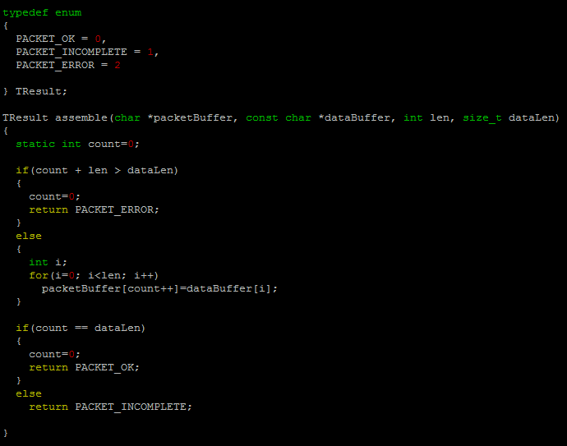
Bonus Complication
Now we write the code to re-assemble the packet fragments:

Slide 31
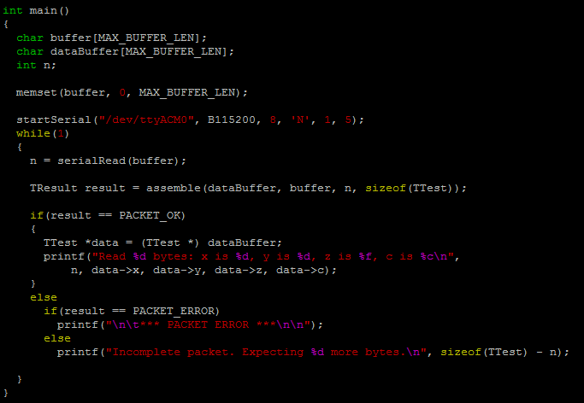
Bonus Complication
Then we change our main to call assemble:

Slide 32
Full Serialization / Deserialization Code
Please see the serialize.zip file for the full serialization/deserialization code.
As this is a rather complicated topic:
Please use the code in this file for your studios.
However you MUST understand how it works.
In particular we use the Tcomms data structure to store the data to be sent, the length of the data, and a checksum.
We also add a magic number. When we receive a packet, we check the magic number to ensure that this is valid packet.

